Slide 1
The best location to set up restaurants in Toronto Canada
Daniel Suhendro

Slide 2
The Problem
What is the best location to set up restaurants in Toronto Canada and what is the right kind of restaurants to set up there?
For those that wants to set up restaurant business in Toronto Canada.

Slide 3
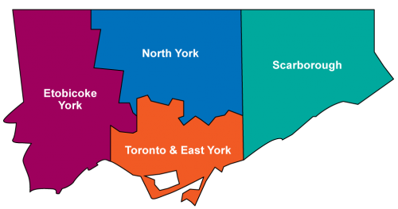
Area division in Toronto
Set restaurant here
Etobicoke York: 34 persons/hectare
North York: 42 persons/hectare
Toronto & East York: 80 persons/hectare
Scarborough:34 persons/hectare

Slide 4
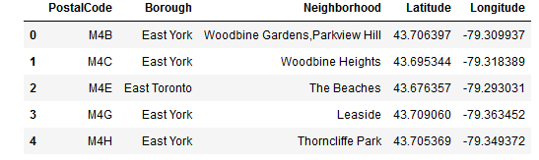
Where in Toronto & EY should set up restaurant?
Postal codes combined with geospatial coordinates.

Slide 5
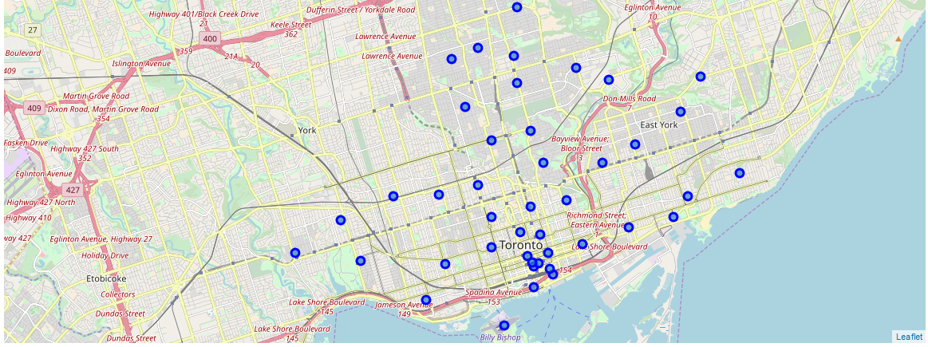
Map of the postal code areas

Slide 6
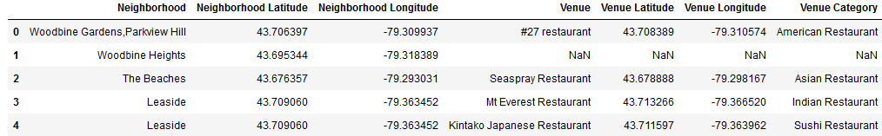
Restaurant dataset
The coordinates were inputted to the Foursquare search engine, resulting in another dataset.

Slide 7
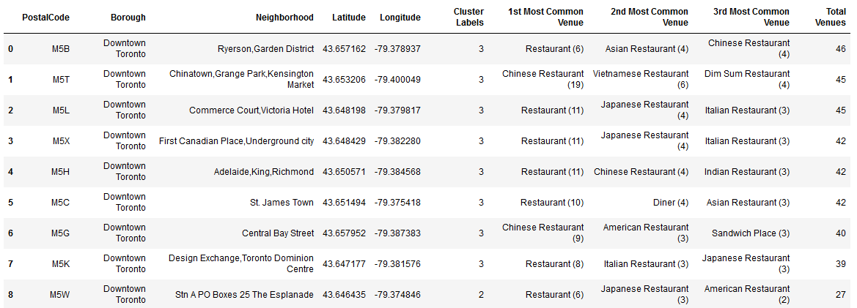
Processing the data
That dataset was processed further ending with this dataset

Slide 8
Meaning of the dataset
The area with most restaurants are Ryerson and Garden District in Downtown Toronto. Since restaurants are very popular here, this area is the best location to set up new restaurant.
The most popular category of restaurant is “restaurant” assumed to be serving Canadian cuisine since this is in Canada. This is the best kind of restaurant to set up.

Slide 9
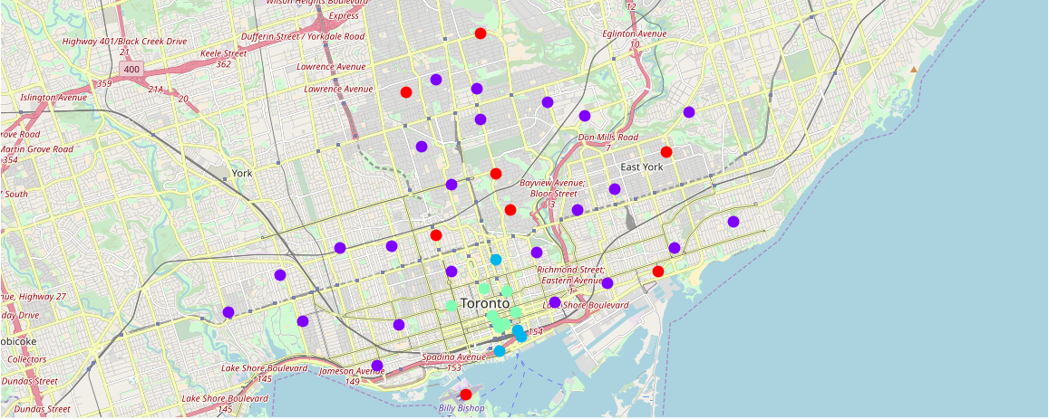
Clustering the area based on the number of restaurants

Slide 10
Meaning of the clusters
The borough with high number of restaurants (cyan) is the Downtown Toronto. This is the best general area to set up a new restaurant.
The purple and the blue areas have fewer restaurants and the red areas have no restaurants in 500 m radius.
Cyan areas also mean highest competition for restaurant business while red areas also mean no competition for restaurant business.

Slide 11
Recommendation and Conclusion
The best area to open up restaurant business is in the Downtown Toronto borough, in the neighbourhood of Ryerson and Garden district.
The best category of restaurant to open is restaurants that serve Canadian cuisine.
Can also choose other areas for lower competition, but also higher risk of business not successful for long.
For the red areas with no restaurants, additional data and research are needed to find out the feasibility of opening up restaurants there.

Slide 12
Thank you for your attention

